Slide 1
ECE 551 Digital Design And Synthesis
Fall ‘17
Counters are Common
Shifters/Rotators
Parameters
Proper SM Coding
Random Misc Stuff

Slide 2
Administrative Matters
Readings
Cumming SNUG paper quiz on Weds Oct 11th
Quiz on Video09 and Video10 (Lecture05) on Monday Feb 9th
Cummings paramdesign paper for hdlcon (posted on class website)
HW3 Posted(a difficult one)
Midterm
Weds Oct 25th 7:15PM in EH1800
Alternate is 48hrs earlier in ??
Taking the alternate has to be cleared with Hoffman

Slide 3
What Have We Learned?
Sequential elements (flops & latches) should be inferred using non-blocking “<=“ assignments
Combinational logic should be inferred using blocking “=“ statements.
Blocking and non-Blocking statements should not be mixed in the same always block.
Plus 5 other guidelines of good coding outlined in the Cummings SNUG paper.

Slide 4
Engineers are paid to think, Pharmacists are paid to follow rules
Counters are commonly needed blocks.
rst_n
Increment logic & mux are combinational ➔ blocking
Flop is seqential. ➔ non-blocking
0
R
+1
comb
cnt[7:0]
1
en
clk
8-bit counter with reset & enable

Slide 5
Pill Counter (follow all the rules)
module pill_cnt(clk,rst_n,en,cnt);
input clk,rst_n;
output [7:0] cnt;
reg [7:0] nxt_cnt,cnt;
always @(posedge clk, negedge rst_n)
if (!rst_n)
cnt <= 8’h00;
else
cnt <= nxt_cnt;
always @(en or cnt)
if (en)
nxt_cnt = cnt + 1; // combinational
else
nxt_cnt = cnt; // so use blocking
endmodule
Nothing wrong with this code
Just a little verbose. Use DF?
module pill_cnt(clk,rst_n,en,cnt);
input clk,rst_n;
output [7:0] cnt;
reg [7:0] cnt;
wire [7:0] nxt_cnt;
always @(posedge clk, negedge rst_n)
if (!rst_n)
cnt <= 8’h00;
else
cnt <= nxt_cnt;
assign nxt_cnt = (en) ? cnt+1 : cnt;
endmodule

Slide 6
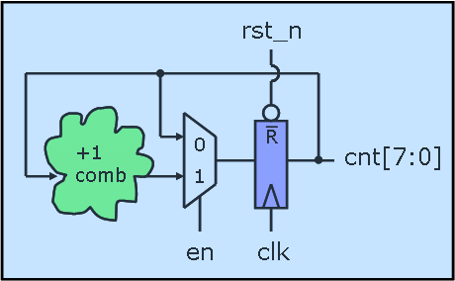
I.Q. Counter (the rebel engineer)
module iq_cnt(clk,rst_n,en,cnt);
input clk,rst_n;
output [7:0] cnt;
reg [7:0] cnt;
always @(posedge clk or negedge rst_n)
if (!rst_n)
cnt <= 8’h00;
else if (en)
cnt <= cnt + 1; // combinational
endmodule
What 2 rules are broken here?
Code infers combinational using a non-blocking assignment
We are using an if statement without a pure else clause
Is this OK?

Slide 7
Ring Counter
module ring_counter (count, enable, clock, reset);
output reg [7: 0] count;
input enable, reset, clock;
always @ (posedge clock or posedge reset)
if (reset == 1'b1) count <= 8'b0000_0001;
else if (enable == 1’b1) begin
case (count)
8’b0000_0001: count <= 8’b0000_0010;
8’b0000_0010: count <= 8’b0000_0100;
…
8’b1000_0000: count <= 8’b0000_0001;
default: count <= 8’bxxxx_xxxx;
endcase
end
endmodule
What do you think of this code?

Slide 8
Ring Counter (a better way)
module ring_counter (count, enable, clock, reset_n);
output reg [7: 0] count;
input enable, reset, clock;
always @ (posedge clock or negedge reset_n)
if (!reset_n) count <= 8'b0000_0001;
else if (enable) count <= {count[6:0], count[7]};
endmodule
Use vector concatenation in this example to be more explicit about desired behavior/implementation
More concise
Does not rely on synthesis tool to be smart and reduce your logic for you.

Slide 9
Rotator
module rotator (Data_out, Data_in, load, clk, rst_n);
output reg [7: 0] Data_out;
input [7: 0] Data_in;
input load, clk, rst_n;
always @ (posedge clk or negedge rst_n)
if (!rst_n) Data_out <= 8'b0;
else if (load) Data_out <= Data_in;
else if (en) Data_out <= {Data_out[6: 0], Data_out[7]};
else Data_out <= Data_out
endmodule
Think what this code implies…How will it synthesize?
What would such a block be used for?

Slide 10
Shifter
always @ (posedge clk) begin
if (rst) Data_Out <= 0;
else case (select[1:0])
2’b00: Data_Out <= Data_Out; // Hold
2’b01: Data_Out <= {Data_Out[3], Data_Out[3:1]}; // ÷ by 2
2’b10: Data_Out <= {Data_Out[2:0], 1’b0}; // X by 2
2’b11: Data_Out <= Data_In; // Parallel Load
endcase
end
endmodule
Think what this code implies…How will it synthesize?
Is the reset synchronous or asynchronous?
There is no default to the case, is this bad?
Why was the MSB replicated on the ÷ by 2

Slide 11
Aside (a quick intro to parameters)
parameter ➔ like a local `define
Defined locally to the module
Can be overridden (passed a value in an instantiation)
There is another method called defparam (don’t ever use it) that can override them
localparam ➔ even more local than parameter
Can’t be passed a value
defparam does not modify
Only available in Verilog 2001 & newer

Slide 12
Aside (a quick intro to parameters)
module adder(a,b,cin,sum,cout);
parameter WIDTH = 8; // default is 8
input [WIDTH-1:0] a,b;
input cin;
output [WIDTH-1:0] sum;
output cout;
assign {cout,sum} = a + b + cin
endmodule
module alu(src1,src2,dst,cin,cout);
input [15:0] src1,src2;
…
//////////////////////////////////
// Instantiate 16-bit adder //
////////////////////////////////
adder #(16) add1(.a(src1),.b(src2),
.cin(cin),.cout(cout),
.sum(dst));
…
endmodule
Instantiation of module can override a parameter.

Slide 13
Aside (a quick intro to parameters)
Examples:
parameter Clk2q = 1.5,
Tsu = 1,
Thd = 0;
localparam IDLE = 2’b00;
localparam CONV = 2’b01;
localparam ACCM = 2’b10;
module register2001 #(parameter SIZE=8)
(output reg [SIZE-1:0] q, input [SIZE-1:0] d,
input clk, rst_n);
always @(posedge clk, negedge rst_n)
if (!rst_n) q <= 0;
else q <= d;
endmodule
Read Cummings
paramdesign paper for hdlcon posted on class website

Slide 14
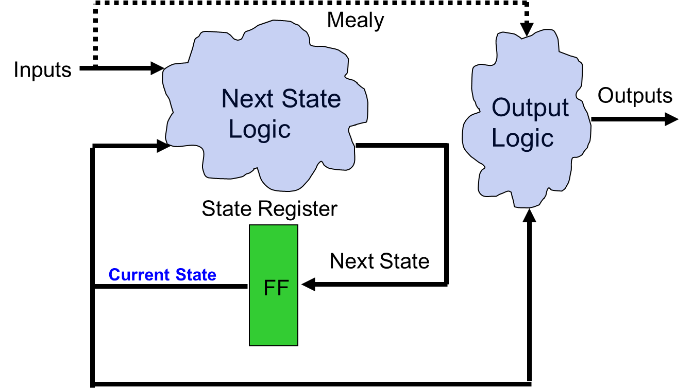
State Machines
State Machines:
Next State and output logic are combinational blocks, which have outputs dependent on the current state.
The current state is, of course, stored by a FF.
What is the best way to code State Machines?:
Best to separate combinational (blocking) from sequential (non-blocking)
Output logic and state transition logic can be coded in same always block since they have the same inputs
Output logic and state transition logic are ideally suited for a case statement

Slide 15
State Diagrams
b=0 / Y=1
a=0 / Y=1
a=1 / Y=1
Outputs Y and Z are 0,
unless specified otherwise.
Is this Mealy or Moore?
a = 0
S0
a = 1/
Z = 1
S1
rst_n = 0
b = 1/ Z = 1, Y=1
S2
Lets code this

Slide 16
SM Coding
always @ (state,a,b)
case (state)
S0 : if (a) begin
nxt_state = S1;
Z = 1; end
else
nxt_state = S0;
S1 : begin
Y=1;
if (b) begin
nxt_state = S2;
Z=1; end
else
nxt_state = S1;
end
S2 : nxt_state = S0;
endcase
endmodule
module fsm(clk,rst_n,a,b,Y,Z);
input clk,rst_n,a,b;
output reg Y,Z;
localparam S0 = 2’b00;
localparam S1 = 2’b01;
localparam S2 = 2’b10;
reg [1:0] state,nxt_state;
always @(posedge clk,
negedge rst_n)
if (!rst_n)
state <= S0;
else
state <= nxt_state;
What problems do
we have here?

Slide 17
SM Coding (2nd try of combinational)
always @ (state,a,b)
nxt_state = S0; // default to reset
Z = 0; // default outputs
Y = 0; // to avoid latches
case (state)
S0 : if (a) begin
nxt_state = S1;
Z = 1;
end
S1 : begin
Y=1;
if (b) begin
nxt_state = S2;
Z=1; end
else nxt_state = S1;
end
default : nxt_state = S0;
endcase
Defaulting of assignments and having a default
to the case is highly recommended!

Slide 18
SM Coding Guidlines
Keep state assignment in separate always block using non-blocking “<=“ assignment
Code state transition logic and output logic together in a always block using blocking assignments
Assign default values to all outputs, and the nxt_state registers. This helps avoid unintended latches
Remember to have a default to the case statement.
Default should be (if possible) a state that transitions to the same state as reset would take the SM to.
Avoids latches
Makes design more robust to spurious electrical/cosmic events.

Slide 19
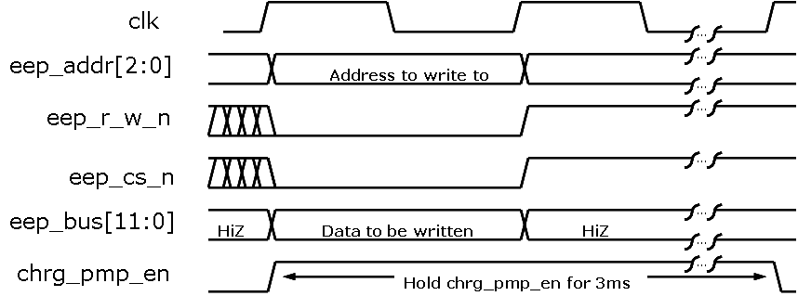
SM Interacting with SM
A very common case is a state that needs to be held for a certain time.
The state machine in this case may interact with a timer (counter).
ChrgPmp
Enable
wr_eep/eep_r_w_n,
eep_cs_n, clr_tmr
tm_eq_3ms/
wrt_done
IDLE
tm_eq_3ms/inc_tm
por_n
rst_n
+1
comb
0
1
0
0’s
1
tm_eq_3ms
Multiple levels of interaction
between SM’s
inc_tm
clr_tm
clk

Slide 20
EEPROM Write SM Example [1]
module eeprom_sm(clk,rst_n,wrt_eep,
wrt_data,eep_r_w_n,eep_cs_n,
eep_bus,chrg_pmp_en,wrt_done);
localparam IDLE = 1’b0;
localparam CHRG = 1’b1;
input clk,por_n,wrt_eep;
input [11:0] wrt_data; // data to write
output eep_r_w_n,eep_cs_n;
output chrg_pmp_en; // hold for 3ms
inout [11:0] eep_bus;
reg [20:0] tm; // 3ms => 21-bit timer
reg clr_tm, inc_tm, bus_wrt;
reg state, nxtState;
//// implement 3ms timer below ////
always @(posedge clk,negedge por_n)
if (!por_n) tm <= 21’h000000;
else if (clr_tm) tm <= 21’h000000;
else if (inc_tm) tm <= tm+1;
//// @500MHZ cnt of 16E360 => 3ms ////
assign tm_eq_3ms = (tm==21’h16E360) ?
1’b1 : 1’b0;
//// implement state register below ////
always @(posedge clk or
negedge por_n)
if (!por_n) state <= IDLE;
else state <= nxtState;

Slide 21
EEPROM Write SM Example [2]
//// state transition logic & ////
//// output logic ////
always @(state,wrt_eep,tm_eq_3ms)
begin
nxtState = IDLE; // default all
bus_wrt = 0; // to avoid
clr_tm = 0; // unintended
inc_tm = 0; // latches
chrg_pmp_en = 0;
case (state)
IDLE : if (wrt_eep) begin
clr_tm = 1;
bus_wrt = 1;
nxtState = CHRG;
end
default : begin // is CHRG
inc_tm = 1;
chrg_pmp_en=1;
if (tm_eq_3ms)
begin
wrt_done = 1;
nxtState = IDLE;
end
else nxtState = CHRG;
end
endcase
end
assign eep_r_w_n = ~bus_wrt;
assign eep_cs_n = ~bus_wrt;
assign eep_bus = (bus_wrt) ?
wrt_data : 12’bzzz;
endmodule

Slide 22
System Verilog SM Coding
One construct verilog was missing was an enumerated type.
For state definition we use localparam in verilog to make code more readable
localparam IDLE = 2’b00;
localparam CONV = 2’b01;
localparam ACCM = 2’b10;
However, in waveform viewing it still shows up as digits. One has to always refer back to the encoding while debugging.
state
00
01
10
01
System verilog adds an enumerated type.
typedef enum reg [1:0] { IDLE, CONV, ACCM } state_t;
state_t state, nxt_state; // declare state and nxt_state signals
state
IDLE
CONV
ACCM
CONV
Makes debug much easier

Slide 23
UART Wrapper
Consider This Application. Collecting 3-bytes from a UART receiver and packaging them into a 24-bit command.
UART_WRAPPER_SM
RX
cmd_rdy
8
capture_high
rdy
RX
0
capture_mid
0
1
rx_data[7:0]
1
clr_rdy
8-bit UART RX
clk
clk
rst_n
clk
[23:16]
cmd[23:0]
[15:8]

Slide 24
SM in System Verilog
module UART_wrapper_sm(input clk, rst_n, …
typedef enum reg [1:0] {HIGH,MID,LOW} state_t;
state_t state, nxt_state;
logic capture_high,capture_mid,set_cmd_rdy,
clr_cmd_rdy,clr_rdy;
/////////// infer state flops ///////////////
always_ff @(posedge clk, negedge rst_n)
if (!rst_n)
state <= HIGH;
else
state <= nxt_state;
always_comb begin
///// default outputs //////
capture_high = 0;
capture_mid = 0
set_cmd_rdy = 0;
clr_cmd_rdy = 0
clr_rdy = 0;
nxt_state = HIGH;
case (state)
HIGH : if (rdy) begin
capture_high = 1;
clr_rdy = 1;
clr_cmd_rdy = 1;
nxt_state = MID;
end
MID : if (rdy) begin
capture_mid = 1;
clr_rdy = 1;
nxt_state = LOW;
end else
nxt_state = MID;
///// default case = LOW /////
default : if (rx_rdy) begin
set_cmd_rdy = 1;
clr_rdy = 1;
nxt_state = HIGH;
end else
nxt_state = CONV;
endcase
end

Slide 25
UART (RS232) Example
LSB
MSB
Start
Bit
(fixed period low)
(like 57600 baud)
Payload goes out
little endian
must have at least 1 period of high at end
(stop bit)
Assume we have a 50MHz clock running our digital system
We want to make a RS232 transmitter with a baud rate of 19,200
How many clock cycles do we hold each bit?
2604 = 12’hA2C

Slide 26
USART Example
module usart_tx(clk,rst_n,strt_tx,tx_data,tx_done,TX);
input clk, rst_n, strt_tx; // start_tx comes from Master SM
input [7:0] tx_data; // data to transmit
output TX; // TX is the serial line
output tx_done; // tx_done asserted back to Master SM
.
.
.
endmodule;
Go over HW3 problem statement

Slide 27
Random Misc Topics
Next slides are a bunch of stuff I wasn’t sure
where to put, but seemed like good information.

Slide 28
Mux With case
module Mux_4_32_(output [31:0] mux_out, input [31:0] data_3, data_2, data_1, data_0, input [1:0] select, input enable);
reg [31: 0] mux_int;
// choose between the four inputs
always @ ( data_3 or data_2 or data_1 or data_0 or select)
case (select) (* synthesis parallel_case *)
2’b00: mux_int = data_0;
2’b01: mux_int = data_1;
2’b10: mux_int = data_2;
2’b11: mux_int = data_3;
endcase
// add the enable functionality
assign mux_out = enable ? mux_int : 32'bz;
endmodule
Case statement implies priority unless use parallel_case pragma
Synthesis directive:
Lets the synthesis tool know to use parallel (mux) scheme when synthesizing instead of
priority encoding. Called an attribute in the IEEE spec

Slide 29
SystemVerilog – Control Constructs
Case and if/else have priority by default in Verilog.
To match this behavior in synthesis, we need a cascade of muxes.
Designers commonly use synopsys parallel_case to force the synthesizer to make a single mux instead.
Synthesizer pragmas give different information to the synthesis tool than to the simulator.
This is fundamentally bad. We want synthesis tool and simulator to have the same information!

Slide 30
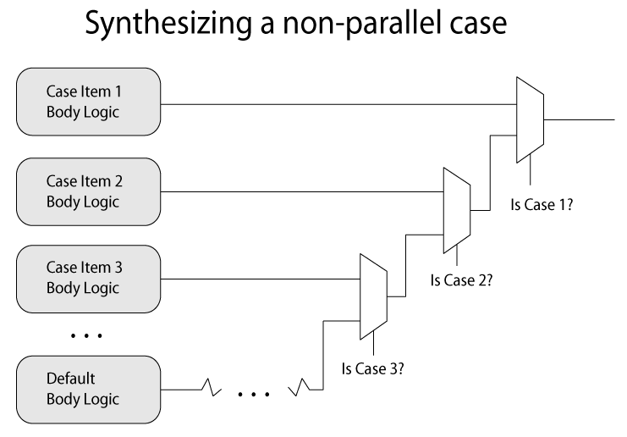
Consider how a case/if else will synthesize

Slide 31
SystemVerilog – Control Constructs
unique keyword modifier
unique case (sel)
CASE1: …
CASE2: …
CASE3: …
endcase
unique tells the synthesizer and simulator that one, and only one, case will be selected
Also works with if: unique if(…) …

Slide 32
SystemVerilog – Control Constructs
priority keyword modifier
priority case (sel)
CASE1: …
CASE2: …
endcase
priority tells the synthesizer and simulator that at least one of the cases will always match. If this doesn’t happen in simulation it will warn you.
Also works with if: priority if(…) …
Easy way to avoid accidental latches!

Slide 33
Encoder With case
module encoder (output reg [2:0] Code, input [7:0] Data);
always @ (Data)
// encode the data
case (Data)
8'b00000001 : Code = 3’d0;
8'b00000010 : Code = 3’d1;
8'b00000100 : Code = 3’d2;
8'b00001000 : Code = 3’d3;
8'b00010000 : Code = 3’d4;
8'b00100000 : Code = 3’d5;
8'b01000000 : Code = 3’d6;
8'b10000000 : Code = 3’d7;
default : Code = 3‘bxxx; // invalid, so don’t care
endcase
endmodule
How do we think it will
synthesize?

Slide 34
Priority Encoder With casex
module priority_encoder (output reg [2:0] Code, input [7:0] Data);
always @ (Data)
// encode the data
casex (Data)
8'b1xxxxxxx : Code = 7;
8'b01xxxxxx : Code = 6;
8'b001xxxxx : Code = 5;
8'b0001xxxx : Code = 4;
8'b00001xxx : Code = 3;
8'b000001xx : Code = 2;
8'b0000001x : Code = 1;
8'b00000001 : Code = 0;
default : Code = 3'bxxx; // should be at least one 1, don’t care
endcase
endmodule
Will this synthesize larger or smaller
than the previous example?

Slide 35
Seven Segment Display
module Seven_Seg_Display (Display, BCD, Blanking);
output reg [6: 0] Display; // abc_defg
input [3: 0] BCD;
input Blanking;
localparam BLANK = 7'b111_1111; // active low
localparam ZERO = 7'b000_0001; // h01
localparam ONE = 7'b100_1111; // h4f
localparam TWO = 7'b001_0010; // h12
localparam THREE = 7'b000_0110; // h06
localparam FOUR = 7'b100_1100; // h4c
localparam FIVE = 7'b010_0100; // h24
localparam SIX = 7'b010_0000; // h20
localparam SEVEN = 7'b000_1111; // h0f
localparam EIGHT = 7'b000_0000; // h00
localparam NINE = 7'b000_0100; // h04
a
f
b
g
e
c
d
Defined constants – can make code more understandable!

Slide 36
Seven Segment Display [2]
always @ (BCD or Blanking)
if (Blanking) Display = BLANK;
else
case (BCD)
4’d0: Display = ZERO;
4’d1: Display = ONE;
4’d2: Display = TWO;
4’d3: Display = THREE;
4’d4: Display = FOUR;
4’d5: Display = FIVE;
4’d6: Display = SIX;
4’d7: Display = SEVEN;
4’d8: Display = EIGHT;
4’d9: Display = NINE;
default: Display = BLANK;
endcase
endmodule
Using the defined constants!

Slide 37
Inter vs Intra Statement Delays
Inter-assignment delays block both evaluation and assignment
#4 c = d;
#8 e = f;
Intra-assignment delays block assignment but not evaluation
c = #4 d;
e = #8 f;
Blocking statement is still blocking though, so evaluation of next statements RHS still does not occur until after the assignment of the previous expression LHS.
What?? How is it any different then? Your confusing me!

Slide 38
Inter vs Intra Statement Delays (Blocking Statements)
module inter();
integer a,b;
initial begin
a=3;
#6 b = a + a;
#4 a = b + a;
end
endmodule
module intra();
integer a,b;
initial begin
a=3;
b = #6 a + a;
a = #4 b + a;
end
endmodule
Compare these two
modules
Yaa, Like I said, they
are the same!
Or are they?
Time | Event
0 | a=3
6 | b=6
10 | a=9
Time | Event
0 | a=3
6 | b=6
10 | a=9

Slide 39
Intra Statement Delays (Blocking Statements)
module inter2();
integer a,b;
initial begin
a=3;
#6 b = a + a;
#4 a = b + a;
end
initial begin
#3 a=1;
#5 b=3;
end
endmodule
module inter2();
integer a,b;
initial begin
a=3;
b = #6 a + a;
a = #4 b + a;
end
initial begin
#3 a=1;
#5 b=3;
end
endmodule
Time | Event
0 | a=3
3 | a=1
6 | b=2
8 | b=3
10 | a=4
Time | Eval Event | Assign Event
0 | nxt_b= 6 | a=3
3 | -- | a=1
6 | nxt_a=7 | b=6
8 | -- | b=3
10 | -- | a=7

Slide 40
Non-Blocking: Inter-Assignment Delay
Delays both the evaluation and the update…effectively becomes a blocking statement
always @(posedge clk) begin b <= a + a; # 5 c <= b + a; # 2 d <= c + a; end
initial begin
a = 3; b = 2; c = 1;
end
Time | Event
0 | clk pos edge
0 | b=6
5 | c=9
7 | d=12

Slide 41
Non-Blocking: Intra-Assignment Delay
Delays the update, but not the evaluation. Does not block
always @(posedge clk) begin b <= a + a; c <= #5 b + a; d <= #2 c + a; end
initial begin
a = 3; b = 2; c = 1;
end
Time | Event
0 | clk pos edge
0 | b=6
2 | d=4
5 | c=5
This is more like modeling the Clk2Q delay of a Flop
(it captures on rising edge, but has a delay till output)

Slide 42
Intra-Assignment Review
module bnb;
reg a, b, c, d, e, f;
initial begin // blocking assignments
a = #10 1; // a will be assigned 1 at time 10
b = #2 0; // b will be assigned 0 at time 12
c = #4 1; // c will be assigned 1 at time 16
end
Note: In testbenches I mainly find blocking inter- assignment delays to be the most useful. Delays really not used outside of testbenches that much during the design process.
initial begin // non-blocking assignments
d <= #10 1; // d will be assigned 1 at time 10
e <= #2 0; // e will be assigned 0 at time 2
f <= #4 1; // f will be assigned 1 at time 4
end
endmodule

